Slide 1


First Homework of Computer Music Languages and Systems A.A.2022/23
Milano, XX mese 20XX
The Disteacher
Group 2 - Circuitone - X. Luan, G. Costa, S. Stagno, A. Paoletti

Slide 2
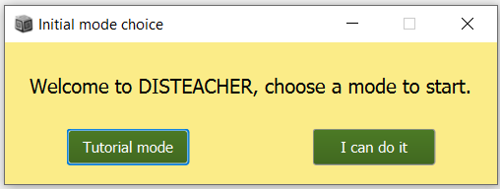
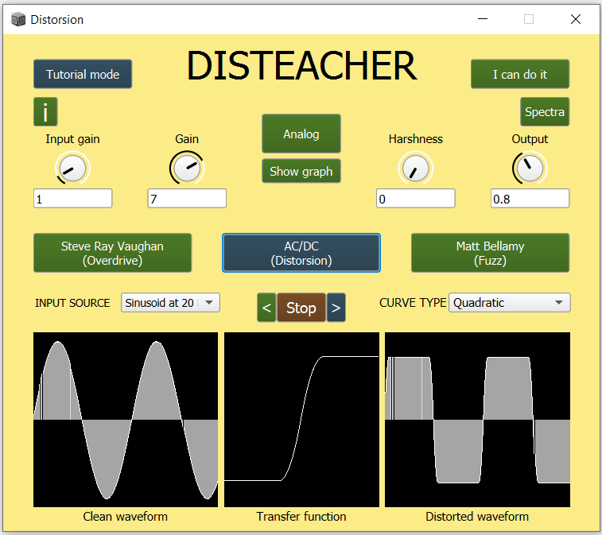
Teaching Distortion
Goal: develop an application to teach how distortion works.
Two usage modalities, one to learn and one to experiment.
Four knobs to change distortion parameters. Three distortion pre-sets to get an idea of how parameters influence the distorted output.
CMLS – HW1

Slide 3
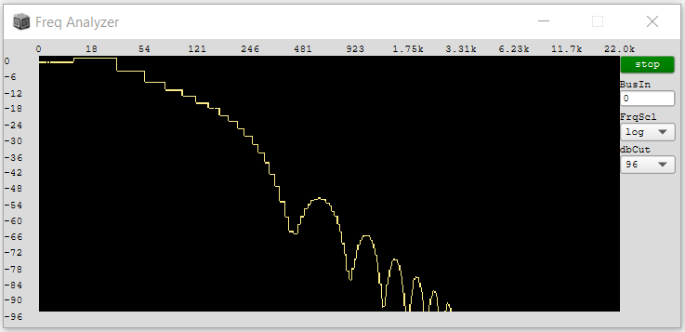
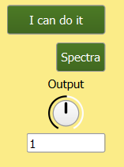
Show Frequency Spectrum
By clicking on the Spectra button in the upper right part of the screen you can see the frequency spectrum of the output soundwave.
CMLS – HW1

Slide 4
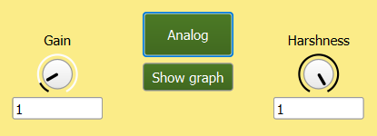
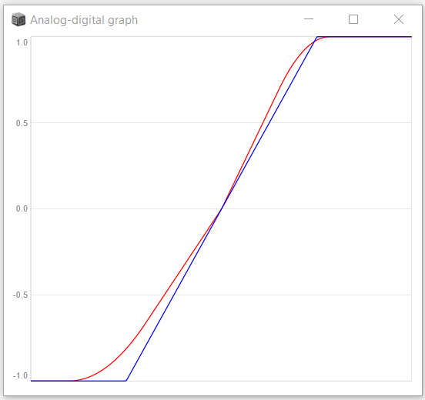
Analog Emulation
By clicking on the central Analog button you can add an analog feel to the distortion function.
If you want to see the difference between the normal and the analog function, just click on the Show graph button.
CMLS – HW1

Slide 5
Conclusioni
AAAA
BBBB
CCCC
DDDD
CMLS – HW1

